Slide 1
Attention Models for PM2.5 Prediction
Jovan Kalajdjieski
Georgina Mirceva
Slobodan Kalajdziski
7th IEEE/ACM International Conference on Big Data Computing, Applications and Technologies

Slide 2
Air pollution
By 2050 70% of the world's population will live in urban centers, which means that we need efficient solutions for monitoring and predicting air pollution
Main cause of death for children under the age of 15, killing 600,000 every year
North America and Australia are the least polluted regions, followed by Central Europe, and India and Asia with the highest air pollution
Air pollution contributes toward 7 million deaths a year and 92% of the world’s population is breathing toxic air

Slide 3
Air pollution in skopje
Frequently given the title the most polluted city in Europe
Natural predisposition contributes towards pollution, but human negligence is a far more influential factor
Main source of air pollutants (around 77%) are combustion processes, followed by transportation (around 14%) and production processes (around 6.5%)
A more comprehensive research is required to find a reliable and effective solution

Slide 4
Air pollution monitoring systems
Many attempt to employ air pollution monitoring systems
Mainly implemented using Internet of Things (IoT) architectures
Consisting of multiple sensors connected wirelessly to monitor the different air pollutants in different regions
Can be used to extract deeper knowledge for pollution

Slide 5
Air pollution prediction systems
Predict the air quality index, the amount of each pollutant and high pollution areas
Approaches generally can be classified into two types:
Models for tracking the generation, dispersion and transmission process of pollutants
Statistical learning models, machine learning and deep learning models

Slide 6
Aim of research
Provide novel attention based long-short term memory models for air pollution prediction
Provide a comprehensive explanation of our models and design decisions
Show and compare our results to the Long-short term memory model (LSTM) and Bidirectional LSTM as a state-of-the-art approaches

Slide 7
Data
Pollution data and weather information for the last three years in Skopje are incorporated
Pollution data was collected from the API endpoints of pulse.eco
Weather information was collected from the API endpoints of World Weather Online
The dataset consists of 563,496 PM_{2.5} pollution entries fused with the previously stated weather information

Slide 8
Proposed approaches
The novel approaches are mainly focused on deep learning architectures, specifically recurrent neural networks
The pollution data has temporal dependencies which means that the current pollution is dependent on the data available for the previous N timesteps
the neural network can decide which available information should be considered, and the appropriate factor for that information
How to determine the factor by which different timesteps affect the current prediction, and the window size of the timesteps?
In our novel models, we propose an attention approach which resolves the problem of determining how much different timesteps affect the current prediction
We show that the size of the window becomes a trade-off with the computational power

Slide 9
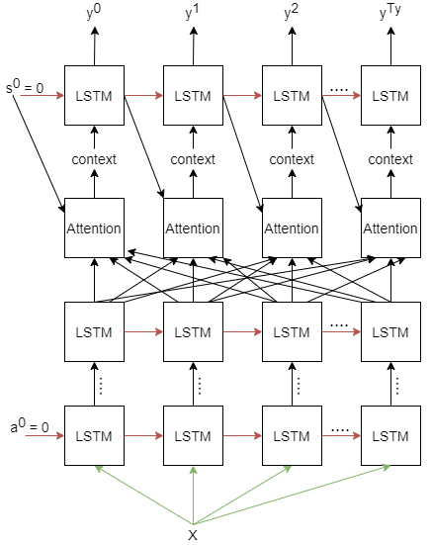
Stacked attention model
This model consists of three main building blocks:
Pre-attention LSTM block
Attention block
Post-attention LSTM block

Slide 10
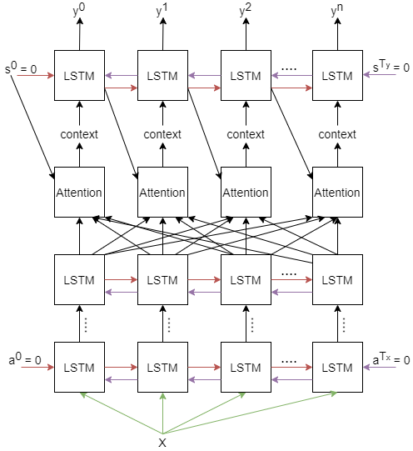
Bidirectional Stacked attention model
This model consists of three main building blocks:
Pre-attention LSTM block
Attention block
Post-attention LSTM block

Slide 11
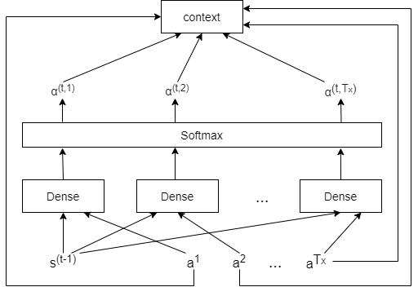
attention mechanism
Allows the model to give different weights or pay different attention to the timesteps used to predict the current pollution value
We employ a new architecture which allows the model to learn the factors of influence at the different timesteps

Slide 12
Experimental setup
To be able to evaluate and compare our novel models, we recreated the state-of-the-art LSTM and Bidirectional LSTM networks
We experimented with different number of stacked layers of these models, but found that 2 stacked layers work the best, because of the data complexity
We have implemented two variations of the two novel models explained in this paper, namely AM with one layer, SAM with two layers, BAM with one layer and BSAM with two layers

Slide 13
evaluation
Models | Training MSE | Testing MSE
Stacked LSTM | 4.91 | 8.92
Bidirectional Stacked LSTM | 4.15 | 7.22
Attention Model | 4.17 | 7.13
Stacked Attention Model | 3.65 | 4.57
Bidirectional Attention Model | 3.73 | 5.52
Bidirectional Stacked Attention Model | 1.98 | 3.41

Slide 14
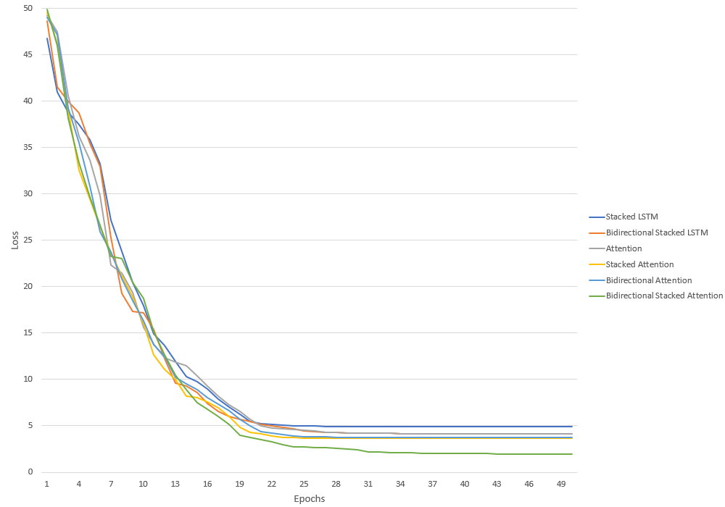
Training over epochs

Slide 15
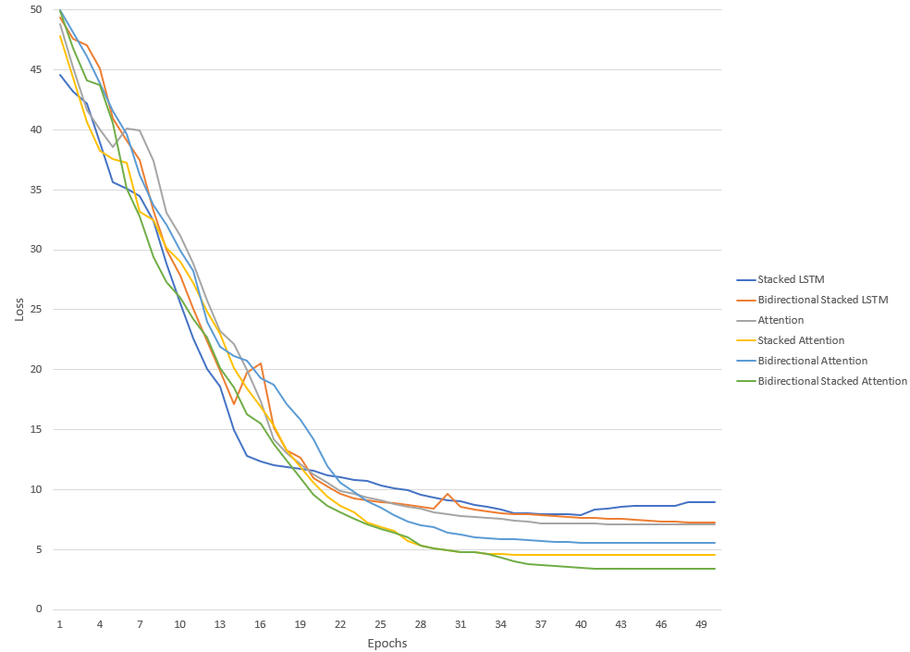
Testing over epochs

Slide 16
conclusion
Our models, even though clearly outperforming the state-of-the-art models, can be further optimized
High MSE can be explained by the fact that many of the sensors had long downtime, so using a simple imputation is not a desirable technique
These models can be extended to predict multiple pollutants, as well as the AQI

Slide 17
Thank you for your attention

