Slide 1



“Comments” on
Modeling Bounded Rationality
Ariel Rubinstein
Tel Aviv and New York Universities
Leiden, Nov 14th, 2014

Slide 2
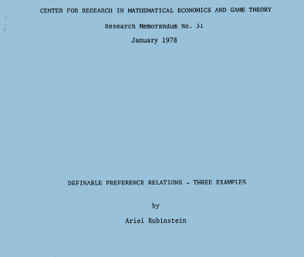
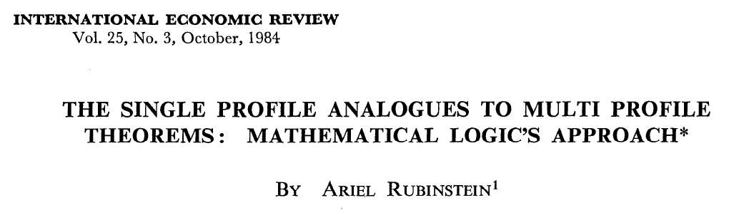
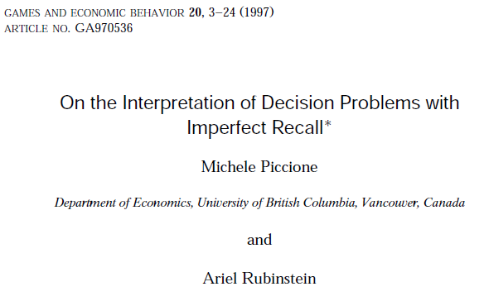
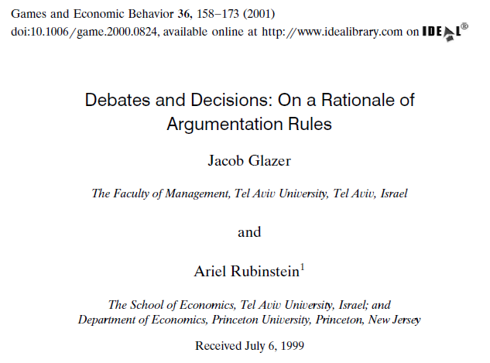
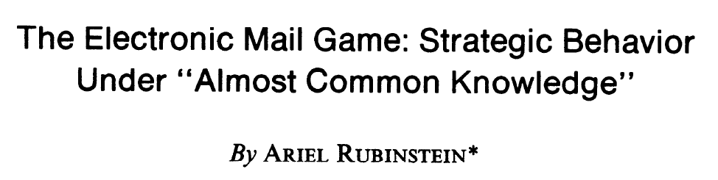
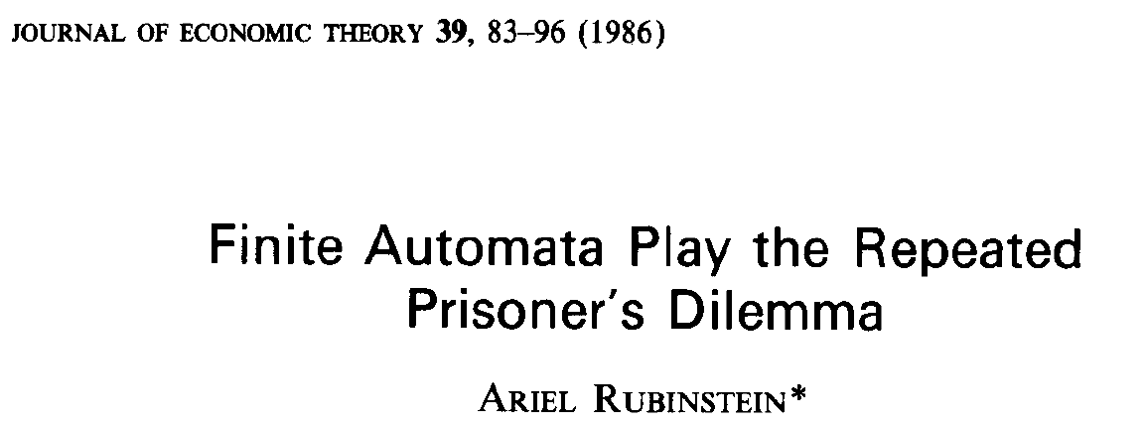
h

Slide 3
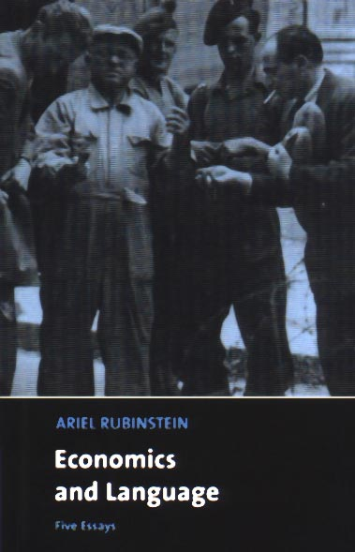

Slide 4
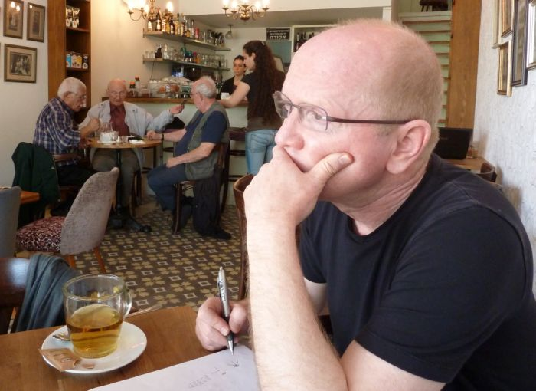
Jacob Glazer working on this paper in the University of Tel Aviv Cafes’ “Labs”

Slide 5
Scenario A
"I went to a bar and was told it was full. I asked the bar hostess what time one should arrive in order to get in. I was told by 12 and once the bar is full you can only get in if you are meeting a friend who is already inside. I lied that my friend was already inside. Without being told, I would not have known which of the possible lies to tell in order to get in."
(M.R. describing an actual experience at a Tel Aviv bar).

Slide 6
Scenario B
As a part of the search process for a candidate for a particular job, a principal wishes to identify those individuals whose preferences over the set of objects {a,b,c} is transitive.
Each individual has to answer three questions of the form:
How do you compare the objects x and y?
I prefer x to y (notated by x≻y)
I prefer y to x (notated by y≻x).

Slide 7
The CODEX:
R1: If a≻b and b≻c then a≻c.
R2: If b≻a and c≻b then c≻a.
R3: If a≻b and a≻c then c≻b.
R4: If c≻a and c≻b then a≻b.

Slide 8

R1: If a≻b and b≻c then a≻c.
R2: If b≻a and c≻b then c≻a.
R3: If a≻b and a≻c then c≻b.
R4: If c≻a and c≻b then a≻b.
a≻b ≻c
a≻c ≻b
T P-T R
a≻b Y Y N N Y N Y N
b≻c N N Y Y Y N Y N
c≻a N Y Y N N Y Y N

Slide 9
R1: If a≻b and b≻c then a≻c.
R2: If b≻a and c≻b then c≻a.
R3: If a≻b and a≻c then c≻b.
R4: If c≻a and c≻b then a≻b.
a≻b ≻c ≻a
a≻b≻c
T P-T R
a≻b Y Y N N Y N Y N
b≻c N N Y Y Y N Y N
c≻a N Y Y N N Y Y N

Slide 10
The procedure we have (essentially) in mind:
Step 1. Examine whether your true profile satisfies the codex.
If it does, then declare (☺) the true profile.
If not, go to Step 2.
Step 2. Find a rule that is violated by your true profile (i.e., your true profile satisfies its antecedent but not its consequent).
Change the consequent and check whether the modified profile satisfies the codex.
If it does, then declare (☺) the new profile.
If not, iterate step 2 (starting with the true profile).
Step 3. If you exhausted Step 2, declare (☹ ) your own profile.

Slide 11
Implementation problem:
Standard approach: Cheating is easy and costless.
Alternative approach: Cheating is limited (Green and Laffont 1986, Glazer and Rubinstein 2006) or costly (Kratik 2009).
Our current approach: The ability to cheat effectively depends on the way the mechanism is constructed and framed.

Slide 12

The platform:
A persuasive situation: a speaker is trying to persuade a listener to take a certain action.

Slide 13
  The speaker knows which profile is true.
  He wishes to persuade the listener to accept his request regardless of the true profile.
  The listener can either accept or reject the request.
  He wishes to accept the speaker's request only if the profile belongs to a given set A.
  The Leader-Follower scenario:
  (1) The listener commits to a persuasion rule, a set of conditions (a codex) that the profile presented must satisfy in order to be accepted.
  (2) The speaker announces a profile.
  (a small problem: the speaker is BOUNDEDLY RATIONAL)
  (3) The listener applies the persuasion rule.

Slide 14

The Model

Slide 15
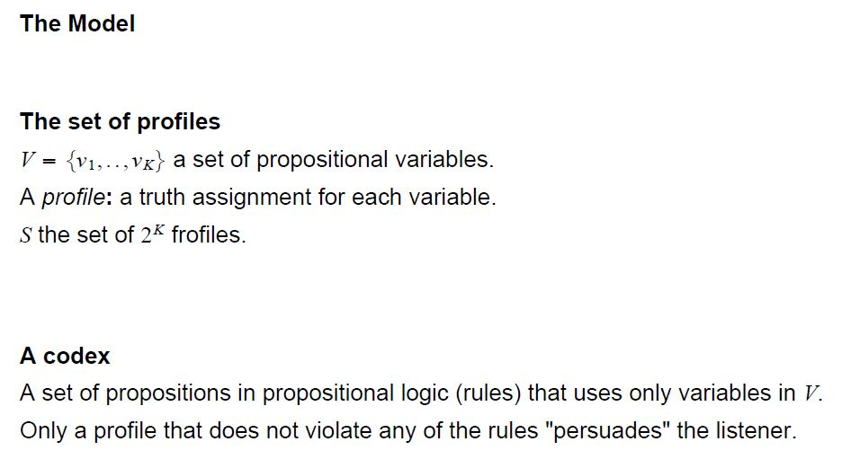

Slide 16
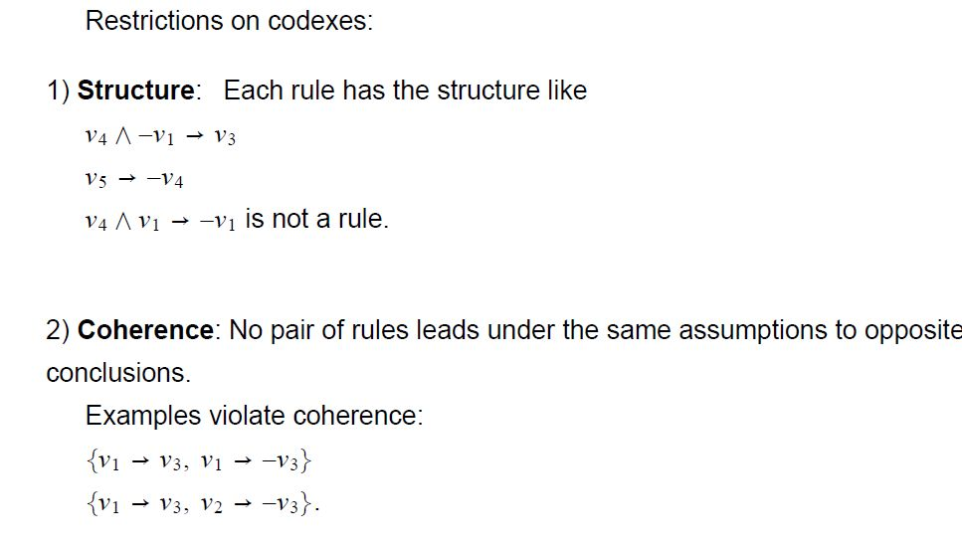

Slide 17
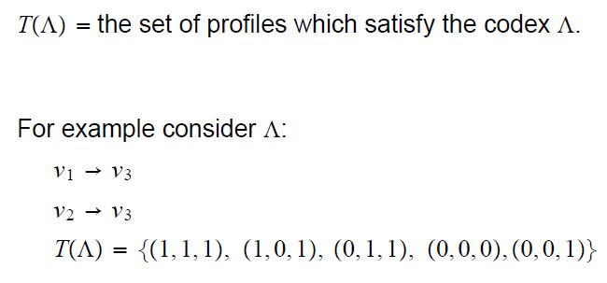

Slide 18
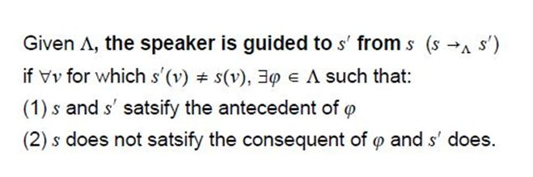
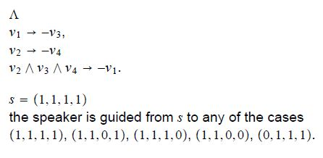
s=(1,1,1,1)
s’=(1,1,0,0)

Slide 19
s=(1,1,1,1)
s’=(0,1,1,1)

Slide 20
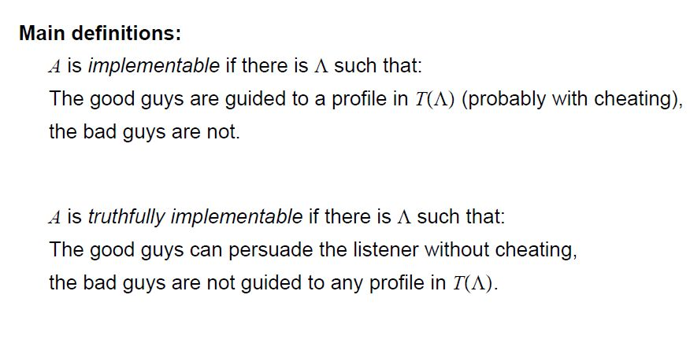

Slide 21

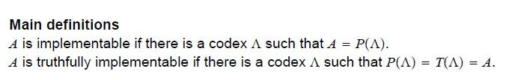

Slide 22
Examples

Slide 23
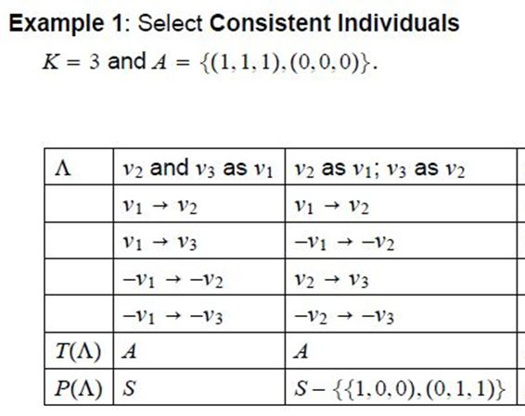

Slide 24
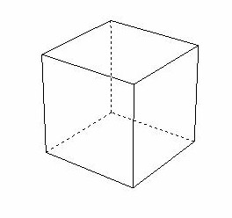
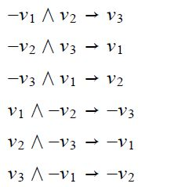
alltrue
1
allfalse

Slide 25
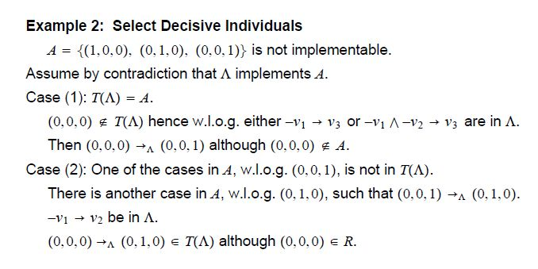
alltrue
allfalse

Slide 26
Auxiliary Results

Slide 27
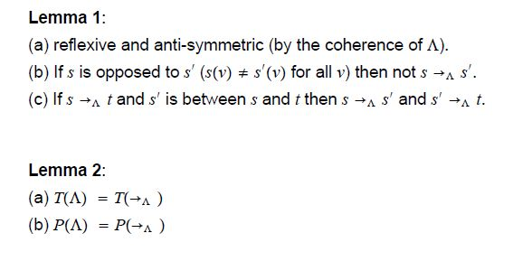
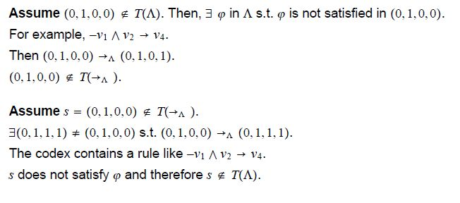

Slide 28
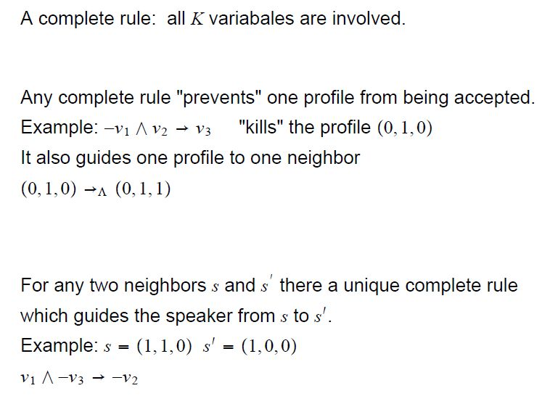

Slide 29
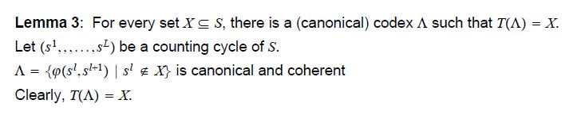

Slide 31
Truthful Implementation

Slide 32
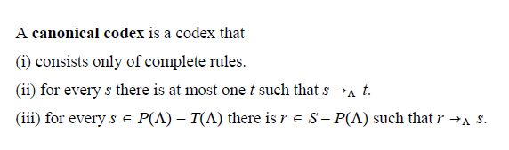

Slide 33
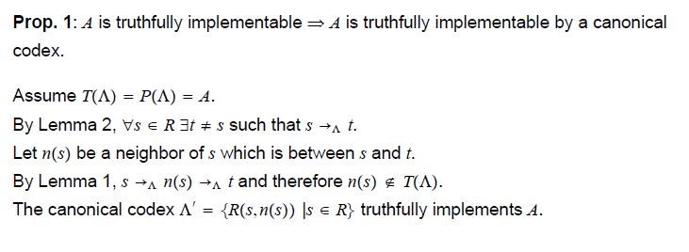

Slide 34


Slide 36
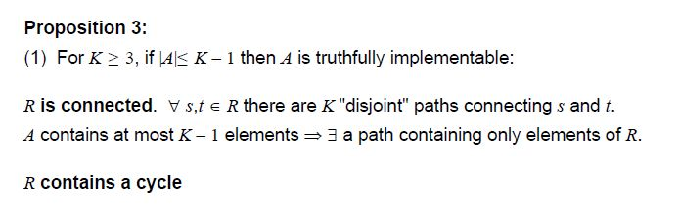
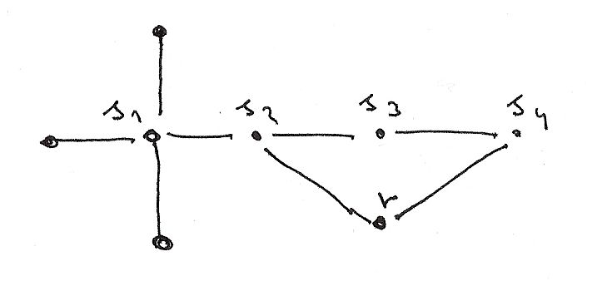

Slide 37
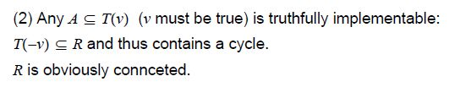
K=4
T(v)
T(-v)

Slide 38
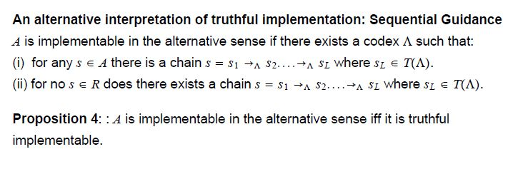

Slide 39
Implementation

Slide 40

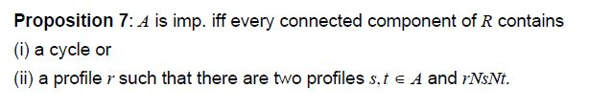

Slide 42
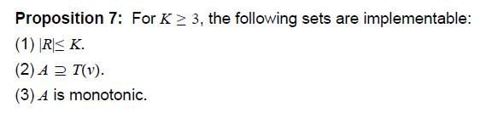

(2) A includes T(v) K=4
T(v)
T(-v)

Slide 43
(2) A includes T(v) K=4
T(v)
T(-v)

Slide 44
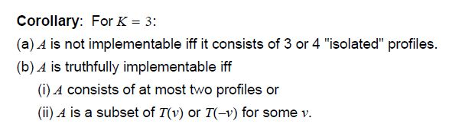

Slide 45
A little experiment

Slide 46
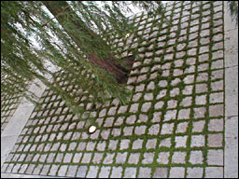
Didactic Web-Based Experiments in GAME THEORY
http://gametheory.tau.ac.il
Site Programming and Design: Eli Zvuluny
Possible Worlds Ltd

Slide 47
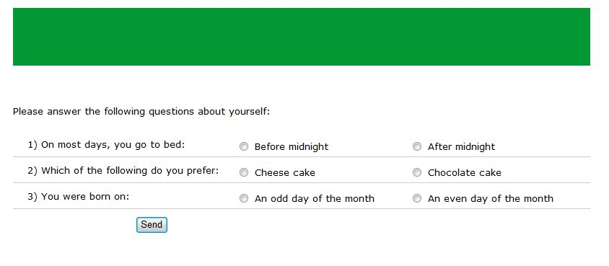

Slide 48
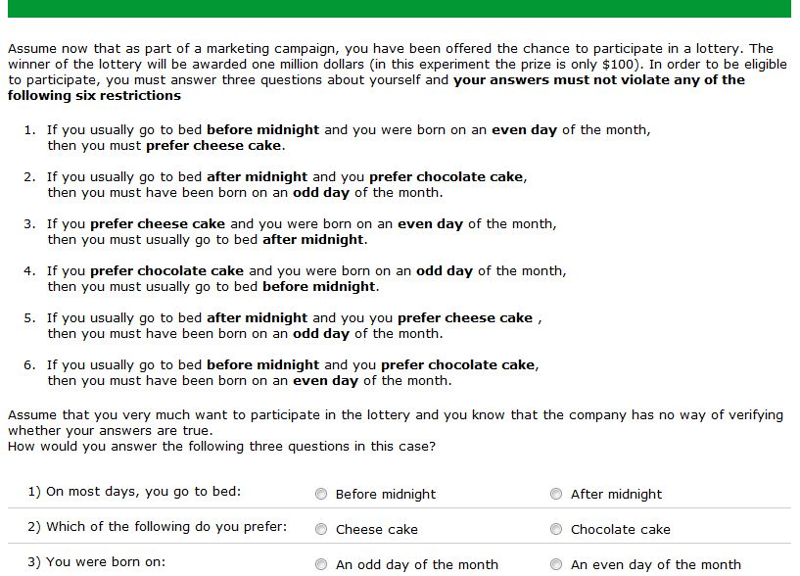

Slide 49
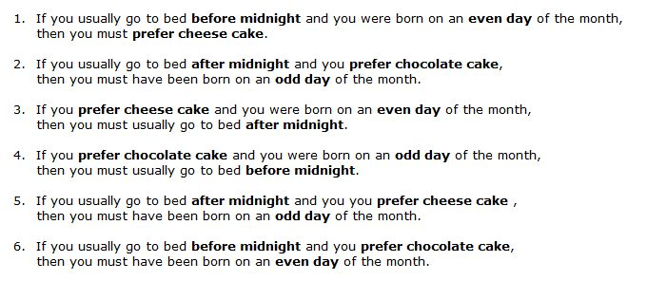
T P-T R
Early Y N Y Y N N Y N
Cheese Y Y Y N Y N N N
Odd N Y Y N N Y Y N

Slide 50
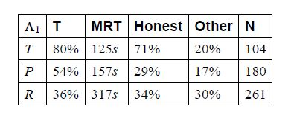

Slide 51
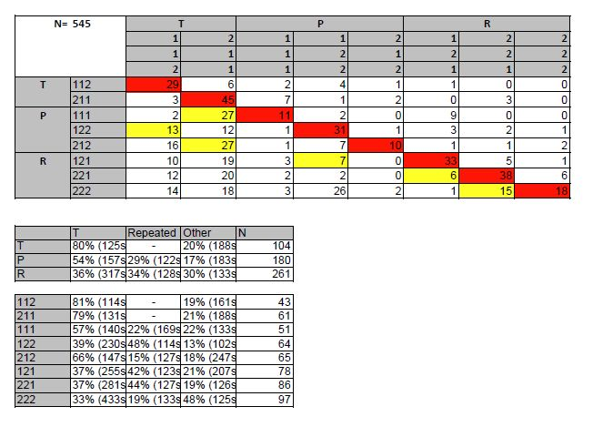
1) Support the basic assumption
2) MRT
3) 68% of P’s who answered correctly followed the guide.
4) 56% of those were honest . Only 9% were not honest and chose unconfirmed profile.
5) An alternative theory: neighbor:
A) (1,1,1) (212) have two neighbors each
B) 221 also has a neighbor

Slide 52
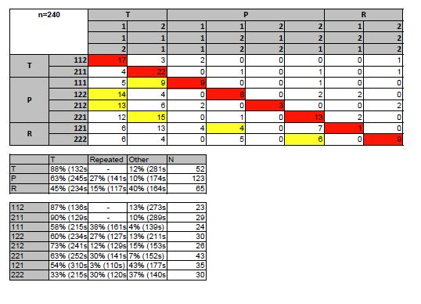

Slide 53
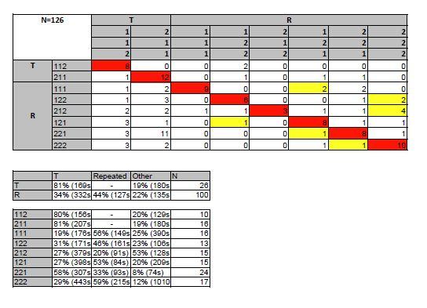

Slide 54
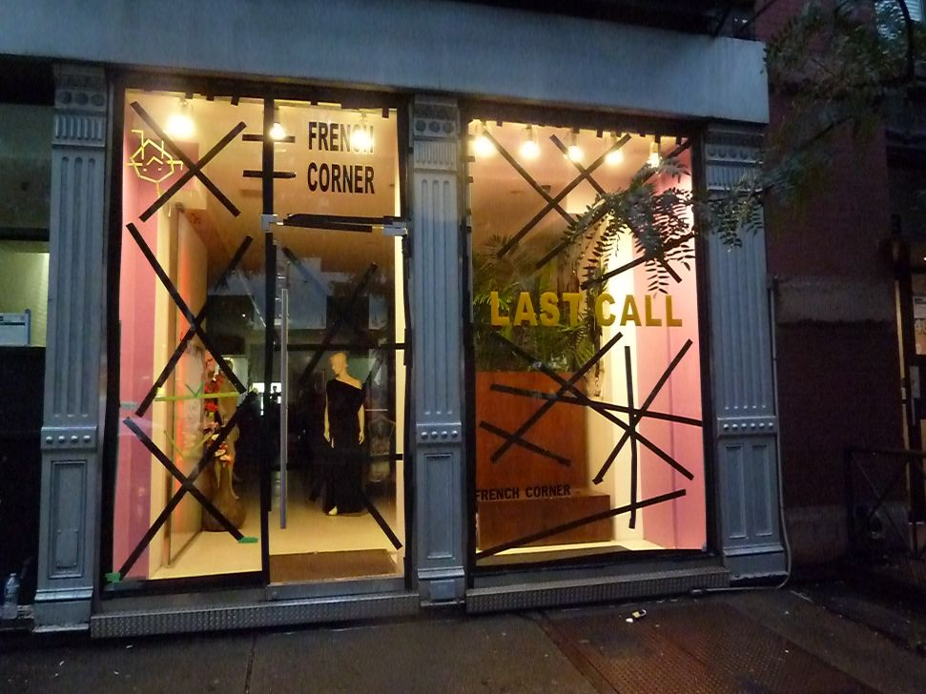

Slide 55
Conclusions

Slide 56
Conclusions (if you insist)
(1) It may be necessary for the listener to use a codex that will guide the speaker to "exaggerate".
(2) If the circumstances in A are rare, then truthful implementation is possible.
(3) If the circumstances in R are rare, then the optimal mechanism may require some of the deserving speakers to (successfully) cheat.
and most importantly:
The model is not intended to closely mirror real-life situations. As always.... it is just a fable and a suggestion for a direction for research into mechanism design with boundedly rational agents.

Slide 57


